Slide 1
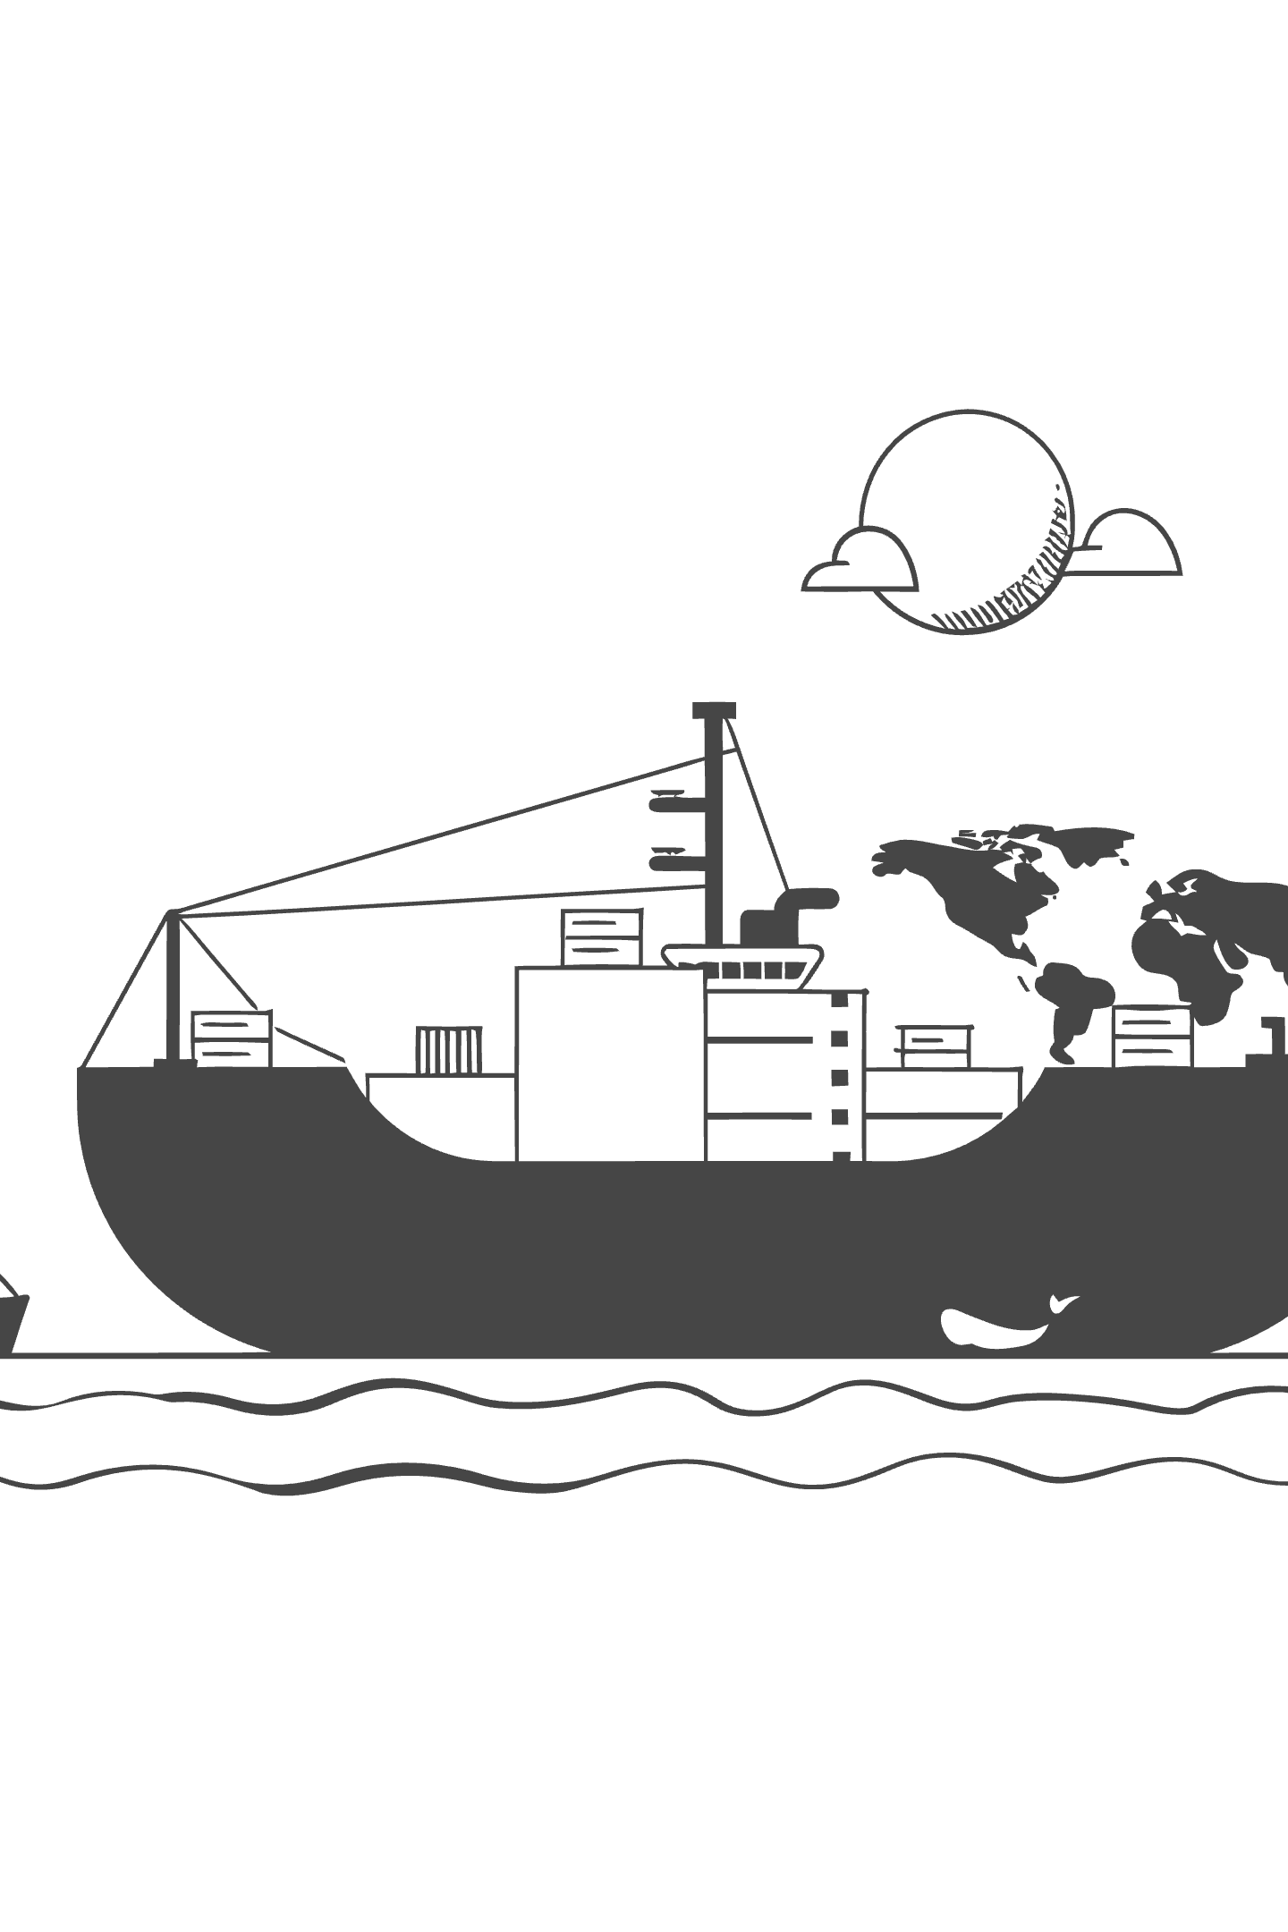
Introduction to Shipping Finance
By Seatusker Ship Management, under the guidance of Prof Vijaykumar, Ocean Engineering IIT Madras
Welcome to one of the most dynamic intersections of global commerce and financial strategy. This course introduces students to the economic, structural, and financial framework that underpins the world's maritime industry — the backbone of international trade.
Through a blend of theoretical foundations and real-world case studies, you will explore how ships are financed, how freight markets work, and how maritime businesses navigate risk and capital in a volatile global environment.
Understand the structure of the global shipping market
Analyse maritime investment and capital allocation strategies
Evaluate shipping contracts, charters, and revenue models

Slide 2






Learning Objectives — Part 1 of 3
By the end of this session, you will understand the economic foundations and market dynamics that drive the global shipping industry.
Global Significance
Capital Intensity
Understand why 90% of world trade moves by sea — and why shipping is as essential to the global economy as roads are to a city. Think of it as the internet of physical goods.
Explain why buying a single large vessel can cost $50–200 million — more than most factories. Shipping rivals oil refineries and airlines in the sheer scale of capital required.
Shipping Market Cycles
Industry Structure
Decode the boom-and-bust rhythm of shipping markets. Like seasons, freight rates rise and fall — and knowing where you are in the cycle determines whether you invest, wait, or sell.
Map the interconnected web of shipowners, operators, charterers, brokers, banks, and ports — understanding how each player's decision ripples across the entire maritime ecosystem.

Slide 3
Lecture Roadmap
This 100-minute session spans 60 slides across eight major sections — combining interactive lectures, case examples, and a group financial exercise — guiding you from foundational concepts to advanced maritime finance.
Section 1
1
Course Introduction & Icebreaker
Welcome & objectives
Why shipping matters
Icebreaker activity
Course overview
Key terminology
2
Section 2
Global Shipping Industry Overview
Scale of global trade
Seaborne cargo volumes
Trade lane geography
Commodity flows
Industry KPIs
Economic impact
Historical evolution
Section 3
3
Maritime Industry Structure
Vessel classes & types
Flag states & registries
Classification societies
Port infrastructure
Regulatory bodies (IMO)
Crewing & labor markets
Supply chain integration
4
Section 4
Shipping Business Models
Liner vs. tramp shipping
Voyage charters
Time charters
Bareboat charters
Pools & consortia
Ownership structures
Operator models
Revenue drivers
Section 5
5
Why Shipping Needs Specialized Finance
Capital intensity explained
Asset lifecycle costs
Newbuild vs. secondhand
Cash flow volatility
Risk concentration
Lender perspectives
Equity vs. debt structures
SPV & tax considerations
6
Section 6
Shipping Cycles & Capital Investment
Supply & demand dynamics
Freight rate cycles
Orderbook analysis
Scrapping decisions
Investment timing
Counter-cyclical strategies
Case study: boom & bust
Section 7
7
Advanced Finance & Market Analysis
Ship finance instruments
Export credit agencies
Capital markets & IPOs
Sale & leaseback
Valuation methods
Risk management & hedging
FFA markets
ESG & green financing
8
Section 8
Group Activity, Quiz & Wrap-up
Group financial exercise
Vessel acquisition case
Financing structure design
Peer presentation
Knowledge quiz
Key takeaways
Further reading
Q&A & close

Slide 4


PART I
0–10 MINUTES
Course Introduction
Setting context, expectations, and the intellectual framing for shipping finance as a discipline.
Everything You Own Came by Ship
What You Will Learn
Before we begin, consider this: the smartphone in your pocket was assembled in Asia and arrived by container ship. The clothes you're wearing today passed through at least one ocean voyage. The coffee or food you had this morning — the raw ingredients were harvested in one continent and transported across the sea to another.
Over 90% of world trade is carried by sea. Shipping is the invisible backbone of the global economy — and yet it is one of the least understood industries in the world of finance.
How the Industry Works
Vessel types, cargo segments, trade routes, and the players who make the maritime world function.
Why Shipping Needs Specialized Finance
Ships are unique assets — capital-intensive, internationally mobile, and exposed to extreme cyclicality.
If global shipping stopped for just two weeks, supermarket shelves would empty, factories would halt, and fuel prices would spike worldwide.
Connecting Theory with Practice
Financial models, real deal structures, and case studies drawn from live transactions in the market.
How to Think Like an Industry Professional
Frameworks used by ship owners, banks, and investors when evaluating opportunities and risk.
An Industry Perspective: Seatusker Ship Management
This course is taught with a direct connection to commercial shipping practice. The instructor brings experience from Seatusker Ship Management, a hands-on operator in the maritime industry — giving this course something most finance programs lack: a practitioner's lens on how decisions are actually made, not just how they appear in textbooks.
🚢 Real Transactions
📊 Industry Data
Case studies are drawn from actual vessel acquisitions, financing structures, and market cycles — not hypothetical scenarios.
We use live market data — freight rates, vessel values, fleet orderbooks — the same data professionals track daily.
🌍 Global Perspective
🤝 Theory Meets Practice
Shipping is inherently international. We will explore financing across jurisdictions, flag states, and global banking relationships.
Every financial concept introduced is immediately tested against how it plays out in real shipping markets.
"Shipping finance is not just about ships — it is about understanding risk, capital allocation, and global trade all at once. Master this, and you can finance almost anything."

Slide 5

The Icebreaker Question
"If all ships stopped sailing today, how many days would it take before supermarkets, industries, and hospitals begin experiencing shortages?"
Take 60 seconds. Think carefully. Then consider what you had for breakfast this morning.
72 Hours
2 Weeks
3 Months
Fuel supply chains begin to strain. Petroleum reserves at refineries start declining.
Supermarkets run out of staple goods. Electronics, clothing, and medicines go unrestocked.
Global industrial output collapses. Famine risk emerges in import-dependent nations.
1
2
3
4
5
5–7 Days
4 Weeks
Fresh produce, seafood, and perishables disappear from shelves. Prices spike.
Widespread fuel shortages. Factories halt production. Hospital supply chains fracture.
📦 Discussion Prompt #1
💬 Discussion Prompt #2
Look around the room right now. List 10 items you can see that arrived by ship.
Which country would be hit hardest within the first week? Consider:
Your phone or laptop — assembled in Asia
Your clothing — likely manufactured abroad
The coffee you drank this morning
Furniture, textbooks, pens, cables...
Island nations (Japan, UK, Singapore)
Countries with high import dependency
Nations relying on LNG or oil imports for energy
Regions dependent on food imports
Share your list with a partner. Were you surprised?
What does this tell us about shipping as a geopolitical lever?
The Numbers: Approximately 90% of world trade moves by sea. Over 11 billion tonnes of cargo are shipped annually. The global merchant fleet numbers more than 50,000 vessels. Shipping finance therefore underpins the infrastructure of civilization itself — not merely commerce.
Why This Matters for Finance
Shipping is not just logistics — it is the circulatory system of the global economy. Every financing decision in this industry carries systemic consequences. A vessel that cannot be financed is a supply chain that fails. Understanding shipping finance means understanding the infrastructure of world commerce itself.

Slide 6

What This Course Is Really About
Shipping finance is not merely about securing loans for vessels. It is about enabling global trade, managing billion-dollar assets, and making long-term investment decisions in one of the world's most volatile and fascinating industries. This course sits at a rare intersection of three disciplines that rarely meet in a single classroom.
Economics
Engineering
Supply-demand dynamics, freight rate formation, market cycles, and the macroeconomic forces that make shipping uniquely sensitive to global trade patterns
Asset characteristics, vessel life cycles, technical management, classification societies, and why a ship's physical condition directly determines its bankability
Law
Finance
Maritime law, flag state regulation, charterparties, cross-border compliance, and the legal frameworks that govern billion-dollar transactions across multiple jurisdictions
Debt structuring, equity markets, leasing, bonds, risk management, and the full spectrum of capital solutions specific to maritime assets
How Shipping Finance Differs From Regular Business Finance
In conventional corporate finance, lenders assess balance sheets, revenue streams, and brand equity. In shipping finance, the calculus is fundamentally different — and far more complex. The asset is the business, and the asset moves across international waters, changes jurisdiction daily, and can lose 40% of its value in a single market downturn.
Ship Mortgages
Sale-Leaseback Transactions
Unlike a property mortgage, a ship mortgage follows an asset that has no fixed address. Lenders must register their security interest in the vessel's flag state, negotiate preferred mortgagee rights, and ensure that arrest rights are enforceable across ports worldwide. A bank financing a Panamax bulker must consider whether it can seize and sell the vessel in Singapore, Rotterdam, or Houston if the borrower defaults — all governed by different legal regimes.
In a sale-leaseback, a shipowner sells a vessel to a financial institution or leasing company — often a Chinese or Japanese lessor — and immediately leases it back on a long-term bareboat charter. The owner unlocks the equity tied up in the vessel while retaining operational control. This has become a dominant financing structure in Asia, where state-backed leasing houses offer cheaper capital than traditional bank debt.
Charter-Backed Loans
The $100M Container Ship — A Real-World Scenario
A charter-backed loan uses a vessel's future earning power as collateral. If a container ship has a 5-year time charter with a creditworthy operator like Maersk or MSC, a lender can structure repayments against those contracted cash flows — effectively lending against the income stream, not just the steel. The charter contract is assigned to the bank, transforming a volatile asset into something closer to a bond.
Consider a Greek shipowner ordering a $100M feeder container vessel from a South Korean yard with delivery in 24 months. They must arrange:
Equity: Typically 20–30%, sourced from retained earnings, private equity, or family capital
Debt: 70–80% via a syndicated loan, export credit agency (ECA) guarantee, or Chinese lessor
Refund guarantee: Protecting pre-delivery installments if the yard defaults
Charter coverage: Ideally a time charter locked before delivery to satisfy lender debt service requirements
Insurance: Hull & Machinery, P&I, and loss-of-hire coverage as mandatory lender conditions
Managing this simultaneously — across Greek, Korean, and international capital markets — is what this course prepares you to do.
This course treats shipping not as a niche sector but as a lens through which to understand global capital flows, asset-backed finance, and the economics of international trade at its most fundamental level.

Slide 7




PART II
10–25 MINUTES
Global Shipping Industry
Shipping is the backbone of world trade — over 90% of everything traded internationally moves by sea. With more than 100,000 vessels sailing the world's oceans, the industry underpins economies from the largest export nations to fast-growing markets like India.
100K+
2.3B
Vessels in Service
GT World Fleet
Active merchant fleet worldwide as of 2024–2025
Total gross tonnage of the global merchant fleet
90%
$14T
Trade by Sea
Annual Trade Value
Share of world merchandise trade carried by shipping
Estimated value of goods transported by sea each year
Major Shipping Nations
India's Growing Role
Ship ownership is highly concentrated among a handful of maritime powers:
India is one of the world's fastest-growing maritime nations, with shipping at the heart of its trade relationships:
🇬🇷 Greece
🇮🇳 → 🇺🇸 USA
🇮🇳 → 🇪🇺 Europe
Largest shipowning nation by tonnage — Greek interests control over 20% of world fleet capacity, dominant in tankers and bulkers.
Pharmaceuticals, textiles, engineering goods, and IT equipment cross the Pacific in container vessels — India's largest export market.
Chemicals, refined petroleum, garments, and gems move westward through the Suez Canal; disruptions in 2024 via Red Sea rerouting added weeks to voyages.
🇯🇵 Japan
🇮🇳 → 🌍 Middle East
Second largest fleet owner; Japanese shipping companies manage vast bulk carrier and car carrier fleets with long-term charter strategies.
India imports crude oil from Gulf states — over 60% of its oil needs — via VLCC tankers, while exporting food, construction materials, and labor services.
🇨🇳 China
India's Sagarmala Programme aims to modernize its 12 major ports and develop a robust coastal shipping and inland waterways network to reduce logistics costs.
Largest fleet by number of vessels and a dominant force in shipbuilding — over 40% of all new vessels are built in Chinese yards.
🇳🇴 Norway
Renowned for specialized shipping — offshore, LNG, and chemical tankers — and home to some of the world's most innovative maritime clusters.
2024–2025 Industry Trends
Green Shipping & Decarbonization
Digitalization & Smart Shipping
Geopolitical Disruption & Rerouting
IMO's 2023 strategy targets net-zero emissions by 2050. Shipowners are investing in LNG dual-fuel engines, methanol-powered vessels (Maersk's methanol fleet), and wind-assisted propulsion. The Carbon Intensity Indicator (CII) rating now affects vessel value and charterability.
AI-driven route optimization, predictive maintenance, and digital twin technology are transforming fleet management. Platforms like Nautilus Labs and Veson Nautical are reshaping how operators monitor performance and negotiate freight. Electronic Bills of Lading (eBL) adoption is accelerating globally.
The 2024 Red Sea crisis forced over 500 vessels per month to reroute around the Cape of Good Hope, adding 10–14 days per voyage and driving a sharp spike in freight rates. This highlighted the industry's vulnerability to chokepoints like Suez, Malacca, and Panama.

Slide 8





What Is Shipping?
Shipping refers to the movement of cargo and passengers via inland, coastal, and international waterways. It is the backbone of globalization — facilitating the flow of raw materials, energy resources, manufactured goods, and food commodities across continents. No other mode of transport can match the scale, cost-efficiency, and reach of maritime transport. A single large bulk carrier can move more cargo in one voyage than thousands of trucks combined.
Shipping is not a support function — it is the primary enabler of the global trading system.
Types of Shipping
Deep Sea Shipping
Short Sea Shipping
Long-haul voyages across major oceans between continents. This is the dominant form of global trade — think Amazon's consumer goods shipped in containers from Chinese factories to US ports, or India's coal imports arriving by bulk carriers from Australia and Indonesia.
Medium-distance routes within a region or between neighbouring countries — for example, cargo moving between European ports or across the Mediterranean. Reduces road congestion and serves as a vital feeder network for deep sea routes.
Coastal Shipping
Inland Waterways
Movement of goods along a country's own coastline, connecting domestic ports. Common in large nations like India, the USA, and Australia where coastal routes offer a cheaper, lower-emission alternative to land transport.
Transport via rivers, lakes, and canals deep within a continent. The Rhine in Europe and the Mississippi in the USA carry enormous volumes of agricultural and industrial cargo. Barges on inland routes are among the most fuel-efficient movers of bulk cargo.
Liner vs. Tramp Shipping
There are two fundamentally different ways shipping services are organised — think of one like a bus service and the other like a taxi.
🚌 Liner Shipping — The Bus
🚕 Tramp Shipping — The Taxi
Liner ships operate on fixed routes, fixed schedules, and published freight rates — just like a bus timetable. Cargo from many different shippers is consolidated into containers aboard the same vessel.
Example: Maersk's Asia–Europe container service departs every week from Shanghai, regardless of whether the ship is full. Amazon, H&M, and Apple all share space on the same vessel.
Tramp ships have no fixed schedule or route. They go wherever the cargo is, hired on demand by a single charterer for a specific voyage or period — just like hailing a taxi.
Example: A steel mill in China needs a full cargo of iron ore from Brazil. It charters a bulk carrier for that single voyage. Tesla uses car carrier vessels (RoRo ships) chartered on demand to ship vehicles from its factories to global markets.
Predictable transit times
Suitable for manufactured goods, retail, electronics
Operated by major alliances (Maersk, MSC, CMA CGM)
Flexible and voyage-specific
Suitable for bulk commodities: coal, grain, ore, crude oil
Rates fluctuate with the Baltic Dry Index (BDI)

Slide 9

The Scale of Global Shipping
11B+
~850M
Tonnes of Cargo
TEUs per Year
Shipped annually by sea — more than all other transport modes combined
Container throughput handled at ports worldwide in 2024, a record high
$25T+
~14M
Value of Goods
Port Calls per Year
Estimated value of goods transported by sea annually — over 80% of world trade by volume
Vessel port calls globally, keeping supply chains moving 24/7 across 150+ maritime nations
How It Compares
A Single Ship vs. The World
Sea freight moves cargo at a fraction of the cost of competing modes:
One modern mega-container ship can carry 24,000 TEU containers — if loaded onto a train, those containers would stretch over 100 kilometres. A single voyage moves what would require thousands of trucks or hundreds of cargo flights.
Air freight: ~50× more expensive per tonne-km than sea
Road: Limited to land corridors; cannot serve intercontinental trade
Rail: Growing, but constrained by gauge differences and land borders
Scale matters: shipping's efficiency per tonne-km is unmatched by any other mode of transport.

Slide 10
Why Shipping Remains the Dominant Mode
For bulk commodities — iron ore, coal, grain, crude oil — no transport mode approaches the cost-efficiency of maritime shipping. Rail is limited by geography; aviation by payload; road transport by distance. The ocean is free, and ships scale magnificently.
10–20x
50–100x
Cheaper Than Rail
Cheaper Than Air
Per tonne-km, maritime shipping undercuts rail freight by an order of magnitude — and rail already beats road significantly
Air freight costs $4–8/kg vs. sea freight at $0.04–0.10/kg. Only time-critical, high-value goods can justify aviation
~0.003
500%
USD per Tonne-Km (Sea)
Fuel Efficiency Gain Since 1990
Bulk dry shipping achieves costs as low as $0.003/tonne-km — rail averages $0.03–0.05, road $0.10–0.20
Modern vessels carry 5x more cargo per tonne of fuel burned than 30 years ago through slow steaming and hull optimization
Why the World's Most Critical Commodities Travel by Sea
🇦🇺 Australian Iron Ore → 🇨🇳 China
🇸🇦 Middle East Oil → Global Markets
📱 iPhone Components → Global Assembly
Moving 900 million tonnes of iron ore annually across 8,000 km of open ocean, Capesize vessels (180,000+ DWT) make it economically viable at under $10/tonne. The same cargo by air would cost $5,000–10,000 per tonne — rendering Chinese steel production impossible. There is simply no rail alternative across the Indian Ocean.
VLCC tankers (Very Large Crude Carriers, 300,000+ DWT) transport crude oil from the Persian Gulf to refineries in Asia, Europe, and the Americas. A single VLCC carries 2 million barrels — worth ~$180M at current prices — at a voyage cost of roughly $2–4M. Pipeline alternatives exist only regionally; aviation is physically impossible for liquid bulk at scale.
A single iPhone sources components from 43+ countries: semiconductors from Taiwan, rare earths from China, aluminum from Australia, display glass from South Korea. Container shipping makes this global supply chain viable — a 40-foot container holds thousands of component shipments at $1,500–3,000 per container, making per-unit freight costs literally pennies.
Economies of Scale: The Bigger the Ship, the Cheaper the Freight
Shipping exploits one of economics' most powerful forces: fixed costs spread over ever-larger volumes. A VLCC carrying 300,000 tonnes costs only marginally more to operate than a vessel carrying 100,000 tonnes — fuel, crew, port fees scale sub-linearly with size. This is why vessel sizes have grown relentlessly over decades.
Handysize
Panamax
10,000–35,000 DWT
Coastal & regional routes, flexible port access
60,000–80,000 DWT
Panama Canal-sized, grain & coal trades
Capesize
VLCC / ULCC
100,000–200,000 DWT
Iron ore & coal, too large for canals
300,000–550,000 DWT
Crude oil supertankers, maximum economies of scale
Fuel Efficiency & Decarbonization Pressure
How Ships Became More Efficient
The Carbon Paradox
Slow steaming: Reducing speed from 25 to 12 knots cuts fuel consumption by up to 50%, as power required scales with the cube of speed
Hull form optimization: Modern bulbous bows and anti-fouling coatings reduce drag by 10–15%
Engine innovations: Two-stroke diesel engines now exceed 55% thermal efficiency — among the highest of any combustion engine
Waste heat recovery: Systems that capture exhaust energy for onboard power generation
Air lubrication: Bubble systems beneath the hull reduce friction with the water
Shipping is the most fuel-efficient mode per tonne-km — yet still emits ~1 billion tonnes of CO₂ annually (≈2.5% of global emissions) simply due to its enormous scale.
The IMO targets net-zero emissions by 2050, driving investment in:
LNG and methanol dual-fuel vessels
Green ammonia propulsion (zero carbon at combustion)
Wind-assisted propulsion (Flettner rotors, rigid sails)
Nuclear propulsion (early-stage commercial feasibility)
The efficiency advantage of shipping is so large that even with decarbonization costs added, it will remain the lowest-cost transport mode for bulk trade for the foreseeable future.

Slide 11
The Importance of Shipping
Economic Importance
Strategic Importance
Facilitates international trade across all major economies
Supports industrial production by ensuring raw material supply
Creates direct and indirect employment for millions globally
Enables energy security through crude oil and LNG transport
Drives national GDP growth, especially in maritime nations
National security and naval logistics
Humanitarian aid delivery in disaster zones
Offshore resource development (oil, gas, wind)
Maritime scientific research and oceanography
Blue economy initiatives: aquaculture, seabed mining, ecotourism

Slide 12
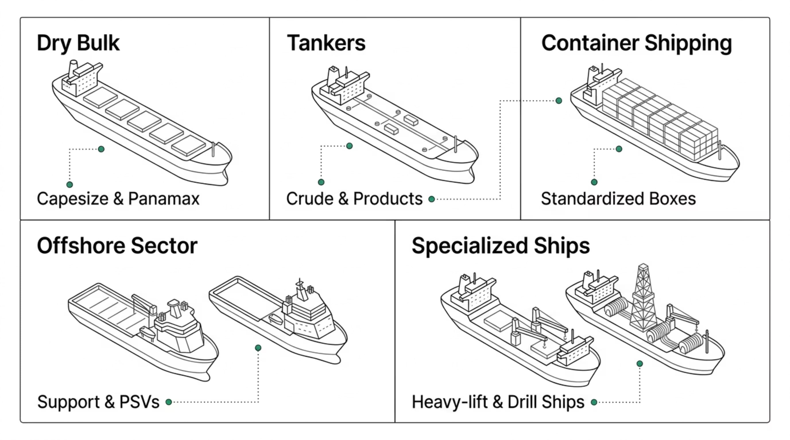
Major Shipping Segments: An Overview
The global merchant fleet is organized into distinct segments based on cargo type and vessel design. Each segment has its own economics, risk profile, and financing characteristics.

Slide 13
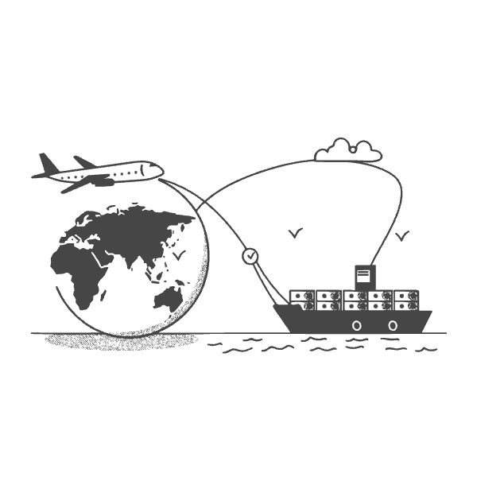
Dry Bulk Shipping
What It Carries
Iron ore — the backbone of global steel production
Coal — thermal (power) and metallurgical (steel)
Grain — wheat, corn, soybeans for food supply chains
Fertilizers — potash, phosphates, urea for agriculture
Key Vessel Classes
Capesize (180,000+ DWT) — too large for Panama/Suez
Panamax (65,000–80,000 DWT) — fits the Panama Canal
Handymax/Supramax (40,000–60,000 DWT) — versatile mid-size
Handysize (15,000–35,000 DWT) — smaller ports, regional trade

Slide 14
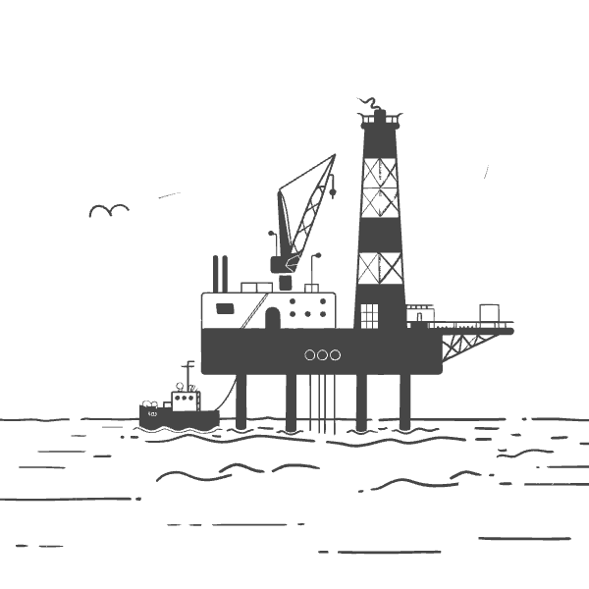
Tanker Shipping
What It Carries
Crude oil — VLCC, ULCC for long-haul trade
Petroleum products — MR, LR1, LR2 tankers
LNG — Liquefied Natural Gas, USD 250M+ vessels
LPG — Propane and butane for cooking and industry
Chemicals — Stainless steel tanks, specialized coatings
Key Classifications
VLCC: 200,000–320,000 DWT
Suezmax: 120,000–200,000 DWT
Aframax: 80,000–120,000 DWT
MR Tanker: 25,000–55,000 DWT

Slide 15
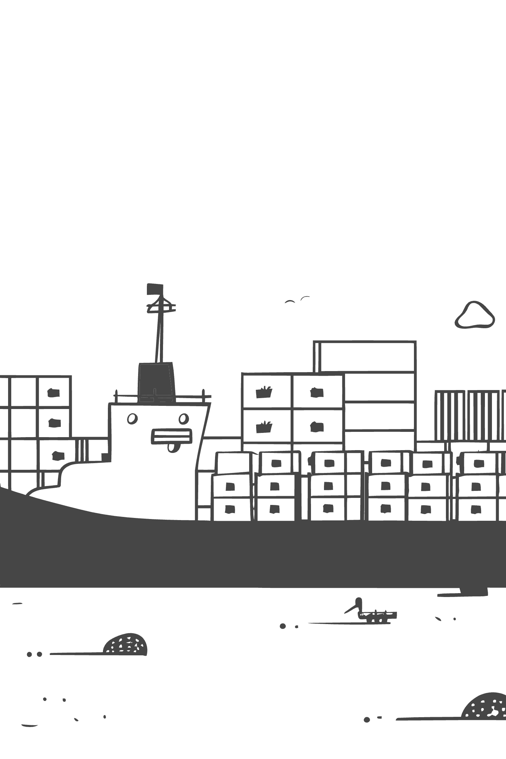
Container Shipping: The Retail Revolution
The invention of the standardized intermodal container by Malcolm McLean in 1956 was arguably the most transformative event in the history of trade logistics. Containers made it possible to load, transport, and unload cargo without repacking at each mode transfer — reducing handling costs by over 90%.
Maersk
Denmark — World's largest container operator by fleet capacity
MSC
Switzerland/Italy — Rapid fleet expansion, now competing for #1 position
CMA CGM
France — Aggressive growth through acquisitions and LNG-powered vessels
COSCO
China — State-backed giant with massive scale in Asia-Pacific trade lanes

Slide 16
Offshore & Specialized Vessels
Offshore Support Fleet
Specialized Ships
AHTS — Anchor Handling Tug Supply: towing rigs, anchor operations
PSV — Platform Supply Vessels: supplies, equipment to offshore platforms
OSVs — Offshore Support Vessels: general offshore operations
Seismic Vessels — Survey the seabed for oil and gas deposits
Cable Layers — Deploy undersea internet and power cables
Heavy-Lift Vessels — Transport offshore platforms, wind turbines
Drill Ships — Deep-water exploration and drilling
Icebreakers — Polar route navigation and research support
Indian Examples: ORV Sagar Nidhi, FORV Sagar Sampada, ORV Sagar Kanya

Slide 17
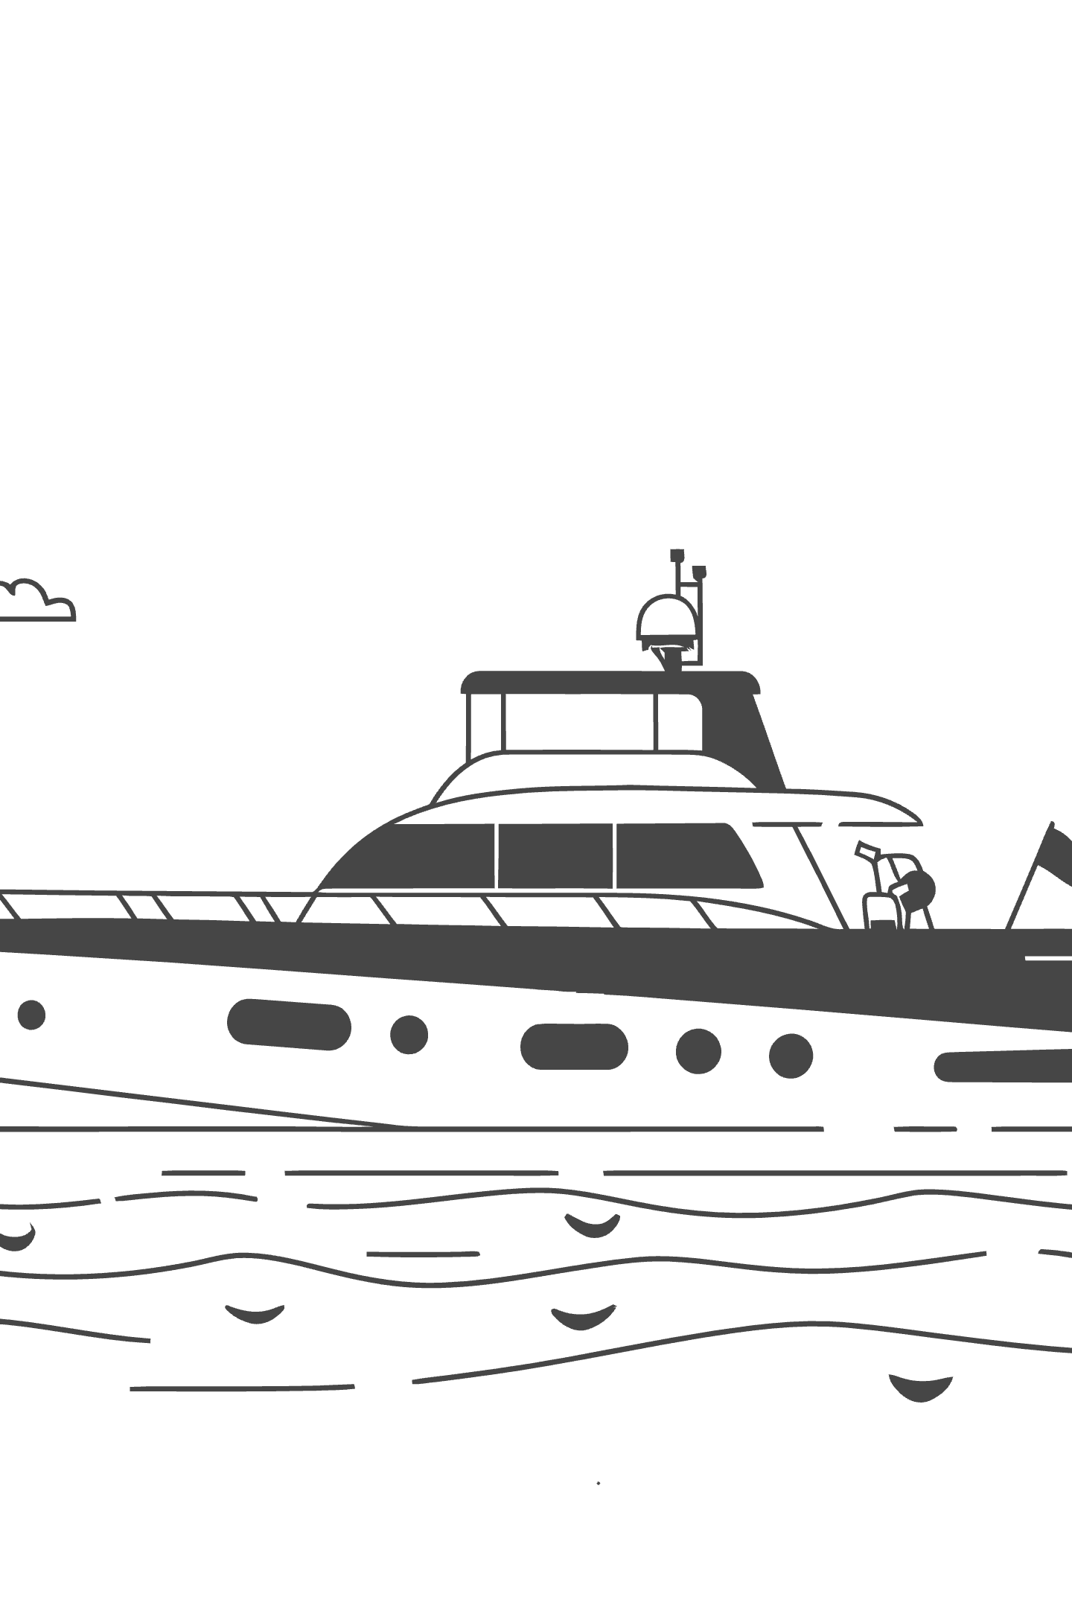
PART III
25–40 MINUTES
Maritime Industry Structure
Mapping the full ecosystem of stakeholders — from shipbuilders and owners to regulators, financiers, and international bodies.

Slide 18
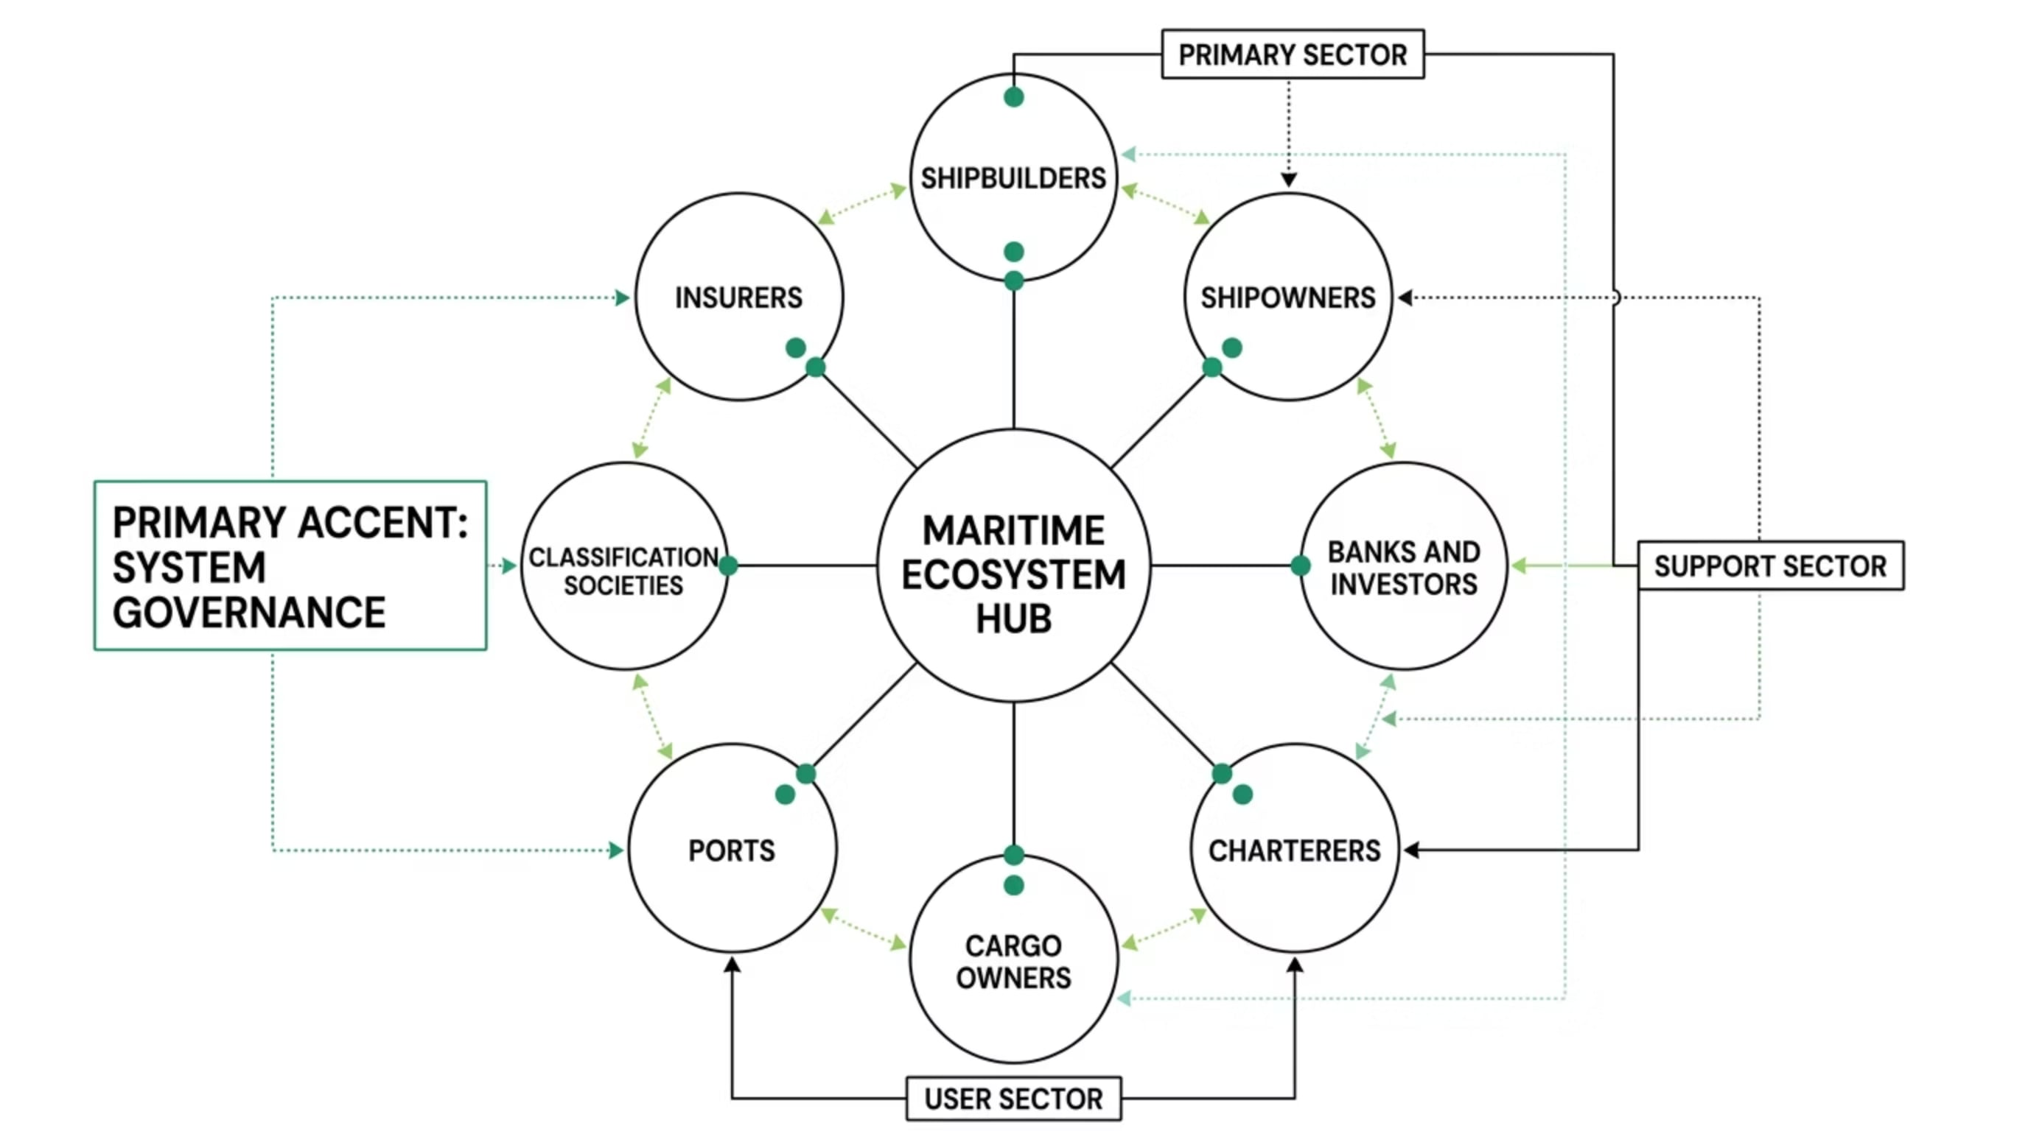
The Maritime Ecosystem
Shipping does not operate in isolation. It is a complex interconnected network of commercial, technical, legal, and regulatory stakeholders — each playing an essential role in the movement of vessels and cargo.

Slide 19
Key Stakeholders in Detail
Shipowners
Classification Societies
Flag States
Own and deploy vessels. Bear capital risk and asset depreciation. May operate directly or through third-party managers.
Lloyd's Register, DNV, Bureau Veritas — certify vessel seaworthiness and safety standards. Required for insurance and port entry.
Grant vessel registration. Popular flags: Panama, Liberia, Marshall Islands. Determine regulatory and tax regime.
Port Authorities
P&I Clubs & Insurers
Provide berths, pilotage, and cargo handling infrastructure. Port efficiency directly impacts shipping economics.
Mutual insurance for liability (P&I), hull and machinery (H&M), and cargo. Essential risk management infrastructure.

Slide 20



International Maritime Organizations
IMO — International Maritime Organization
IACS — International Association of Classification Societies
BIMCO, INTERTANKO, INTERCARGO & ICS
The UN specialized agency responsible for safety, security, and environmental regulations for international shipping. Sets MARPOL, SOLAS, and decarbonization targets.
Industry associations representing shipowners and operators. Develop standard contracts (GENCON, BARECON), lobby regulators, and publish market research.
Coordinates technical standards across 12 major classification societies, ensuring vessel safety through common structural rules.

Slide 21

Indian Maritime Institutions
India's maritime sector is supported by a robust institutional framework that governs shipping operations, safety, shipbuilding, and port development.
DG Shipping
Directorate General of Shipping — apex regulatory body for maritime affairs in India. Issues seafarer certificates and vessel registrations.
SCI
Shipping Corporation of India — India's largest state-owned shipping company. Operates tankers, bulk carriers, and liners.
Cochin Shipyard (CSL)
India's largest public sector shipyard. Builds and repairs naval and commercial vessels. First aircraft carrier INS Vikrant built here.
Major Ports
JNPT (Mumbai), Mundra, Visakhapatnam, Chennai, Haldia — handle India's import-export cargo. Critical to national trade competitiveness.

Slide 22

PART IV
40–60 MINUTES
Shipping Business Models
How do shipping companies generate revenue? Understanding business models is the foundation of understanding shipping finance.

Slide 23



Three Principal Business Models
Every entity in the shipping industry operates through one or more of three fundamental models. The choice of model determines revenue streams, risk exposure, and financing requirements.
Ship Ownership
Ship Management
Chartering
Own and deploy vessels. Earn freight or charter hire. Bear full capital and operational risk.
Manage vessels on behalf of owners. Earn management fees. Asset-light, expertise-driven.
Intermediate between owners and cargo. Take commercial risk, optimize vessel deployment.

Slide 24
Ship Ownership
Revenue Sources
Key Financial Characteristics
Freight Income — earned per voyage or cargo lot
Charter Hire — daily rate under time or bareboat charters
Asset Appreciation — second-hand vessel value gains in bull markets
High upfront capital expenditure (CapEx) — vessels cost millions to hundreds of millions
Long asset lives (20–30 years) require long-term financing strategies
Operational expenses (OpEx): crew, fuel (bunker), maintenance, insurance, port fees
Revenue is volatile — closely tied to freight market cycles

Slide 25

Ship Management
Ship management companies act as specialized operators, running vessels on behalf of owners who prefer to be asset investors rather than active operators. This model has grown significantly with the globalization of shipping.
Technical Management
Crew Management
Vessel maintenance, dry-docking, class compliance, spare parts procurement, and technical inspections.
Seafarer recruitment, training, payroll, certification, and welfare — often across multiple nationalities.
Commercial Management
Safety & Compliance
Chartering, voyage optimization, freight negotiation, and cargo scheduling on behalf of the shipowner.
ISM Code implementation, port state control preparation, MARPOL compliance, and insurance liaison.
Major ship managers include V.Ships, Bernhard Schulte Shipmanagement (BSM), Anglo-Eastern, and Columbia Shipmanagement — collectively managing thousands of vessels worldwide.

Slide 26
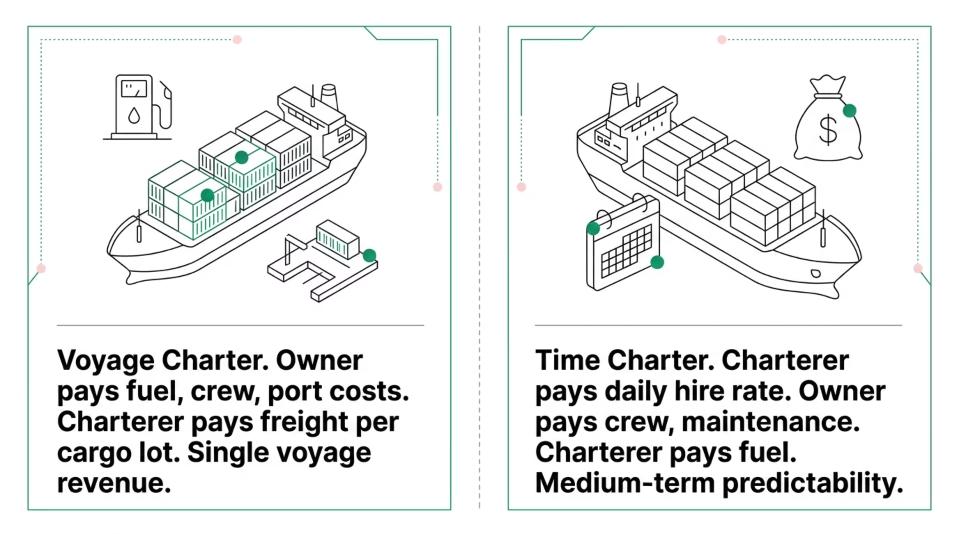
Chartering Models
Chartering defines the legal and commercial relationship between a shipowner and a charterer. The choice of charter type has profound implications for who bears which costs and risks — and therefore shapes the financing structure.

Slide 27
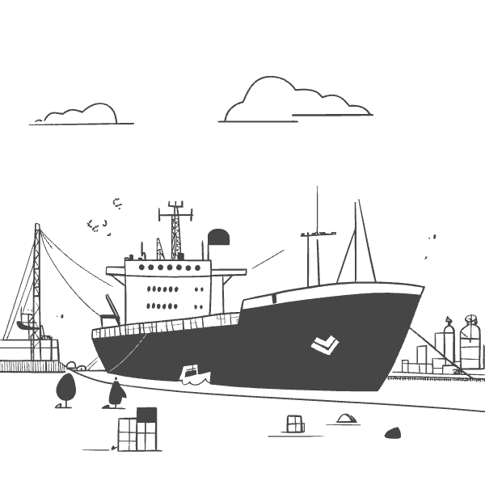
Voyage Charter: Deep Dive
How It Works
The shipowner agrees to carry a specific cargo from one port to another for a fixed freight rate. The owner bears all voyage costs — bunker fuel, port dues, canal tolls — and earns revenue per voyage completed.
Freight Calculation
Freight = Freight Rate ($/tonne) × Cargo Quantity (tonnes)
Subject to laytime clauses (allowed loading/discharge time) and demurrage (penalties for exceeding laytime).
Who Uses It
Tramp operators, bulk cargo owners, spot market traders. High risk, high potential return in strong markets.

Slide 28

Time Charter & Bareboat Charter
Time Charter (TC)
Bareboat Charter (BBC)
Owner provides vessel + crew + maintenance. Charterer directs commercial deployment and pays fuel. Revenue = hire rate × days. Provides predictable cash flow — preferred by lenders as it de-risks loan repayment. Duration: 6 months to 5+ years.
Often called a "demise charter." Charterer takes complete operational and commercial control — hires crew, manages maintenance, pays all costs. Owner receives a fixed lease payment. Frequently used as a financing mechanism, particularly in sale-and-leaseback transactions and Chinese leasing structures.
A key insight: the longer and more stable the charter, the more attractive the vessel is as collateral for bank financing. Time-chartered vessels with strong counterparties command better loan terms.

Slide 29
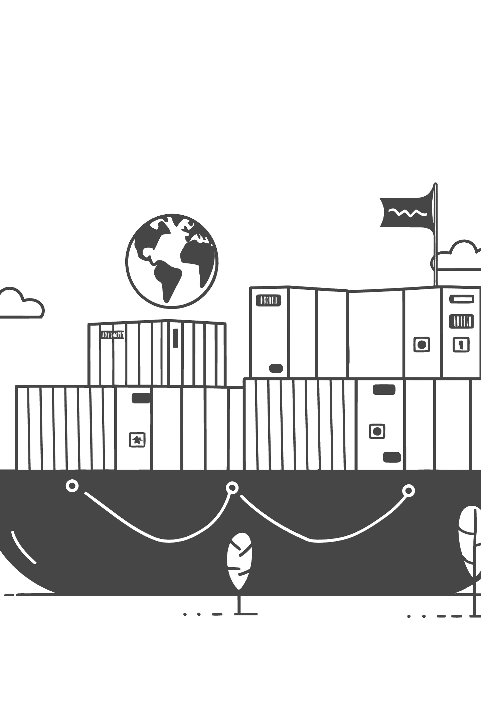
PART V
60–80 MINUTES
Why Shipping Needs Specialized Finance
Shipping's unique financial characteristics mean that conventional corporate finance frameworks are insufficient — and often inapplicable.

Slide 30




Shipping vs. Conventional Corporate Finance
Most corporate finance courses teach frameworks designed for stable, predictable industries. Shipping breaks nearly every assumption those frameworks rely upon.
Extreme Capital Intensity
Long Asset Lives
A single LNG carrier costs USD 250M+. A fleet of 10 vessels represents a multi-billion-dollar asset base — all requiring long-term debt financing.
Ships operate for 20–30 years, creating decades-long financing relationships between owners and lenders. Asset depreciation schedules are complex and market-sensitive.
Revenue Volatility
International Complexity
Freight rates can swing by 500–1,000% within a single market cycle, making cash flow prediction nearly impossible using standard DCF models.
Multi-flag assets, multi-currency revenues, cross-border taxation, and diverse regulatory regimes demand specialized legal and financial expertise.

Slide 31
High Capital Requirements: The Numbers
$250M+
$120M
LNG Carrier
VLCC Tanker
State-of-the-art LNG carrier with membrane containment technology
Very Large Crude Carrier, 300,000 DWT, for long-haul crude trade
$60M
$200M+
Capesize Bulker
Ultra-Large Container
180,000 DWT dry bulk carrier for iron ore and coal trade
24,000 TEU container ship — the largest box ships afloat today
With typical loan-to-value (LTV) ratios of 60–70%, even a single vessel acquisition requires equity commitments of USD 15–100 million. Fleet financing runs into the billions.

Slide 32
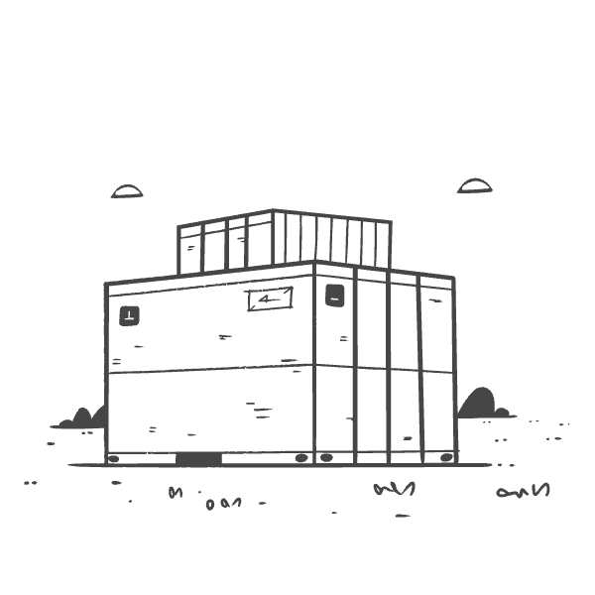
Revenue Volatility: The Freight Rate Challenge
What Drives Freight Rate Volatility?
Global demand — trade volumes, industrial output, commodity flows
Fleet supply — new vessel deliveries and scrapping activity
Geopolitical events — wars, sanctions, canal blockages (Suez 2021)
Fuel prices — bunker costs affect route economics fundamentally
Seasonal demand — grain harvests, winter heating oil demand peaks
Economic cycles — recessions slash trade volumes quickly
The Baltic Dry Index (BDI), the primary benchmark for dry bulk freight rates, fell from a peak of 11,793 in May 2008 to 663 in December 2008 — a 94% collapse in seven months.

Slide 33

International Nature of Shipping Finance
Shipping is inherently cross-border, and this creates a web of financial, legal, and regulatory complexities that no domestic financing framework can fully address.
Exchange-Rate Risk
Multi-Currency Financing
Freight revenues are overwhelmingly denominated in USD, while operating costs may be in EUR, NOK, JPY, or INR. Currency mismatches create significant balance sheet risk.
Loans may be structured in USD, EUR, or JPY depending on the lender's base currency and the borrower's preferences, requiring sophisticated hedging programs.
Cross-Border Taxation
Regulatory Compliance
Flag state selection, beneficial ownership structures, and tonnage tax regimes are all actively used to optimize the tax efficiency of shipping investments.
IMO 2020 sulfur cap, CII ratings, EEXI requirements, and forthcoming carbon pricing create ongoing compliance costs that affect vessel valuations and financing.

Slide 34
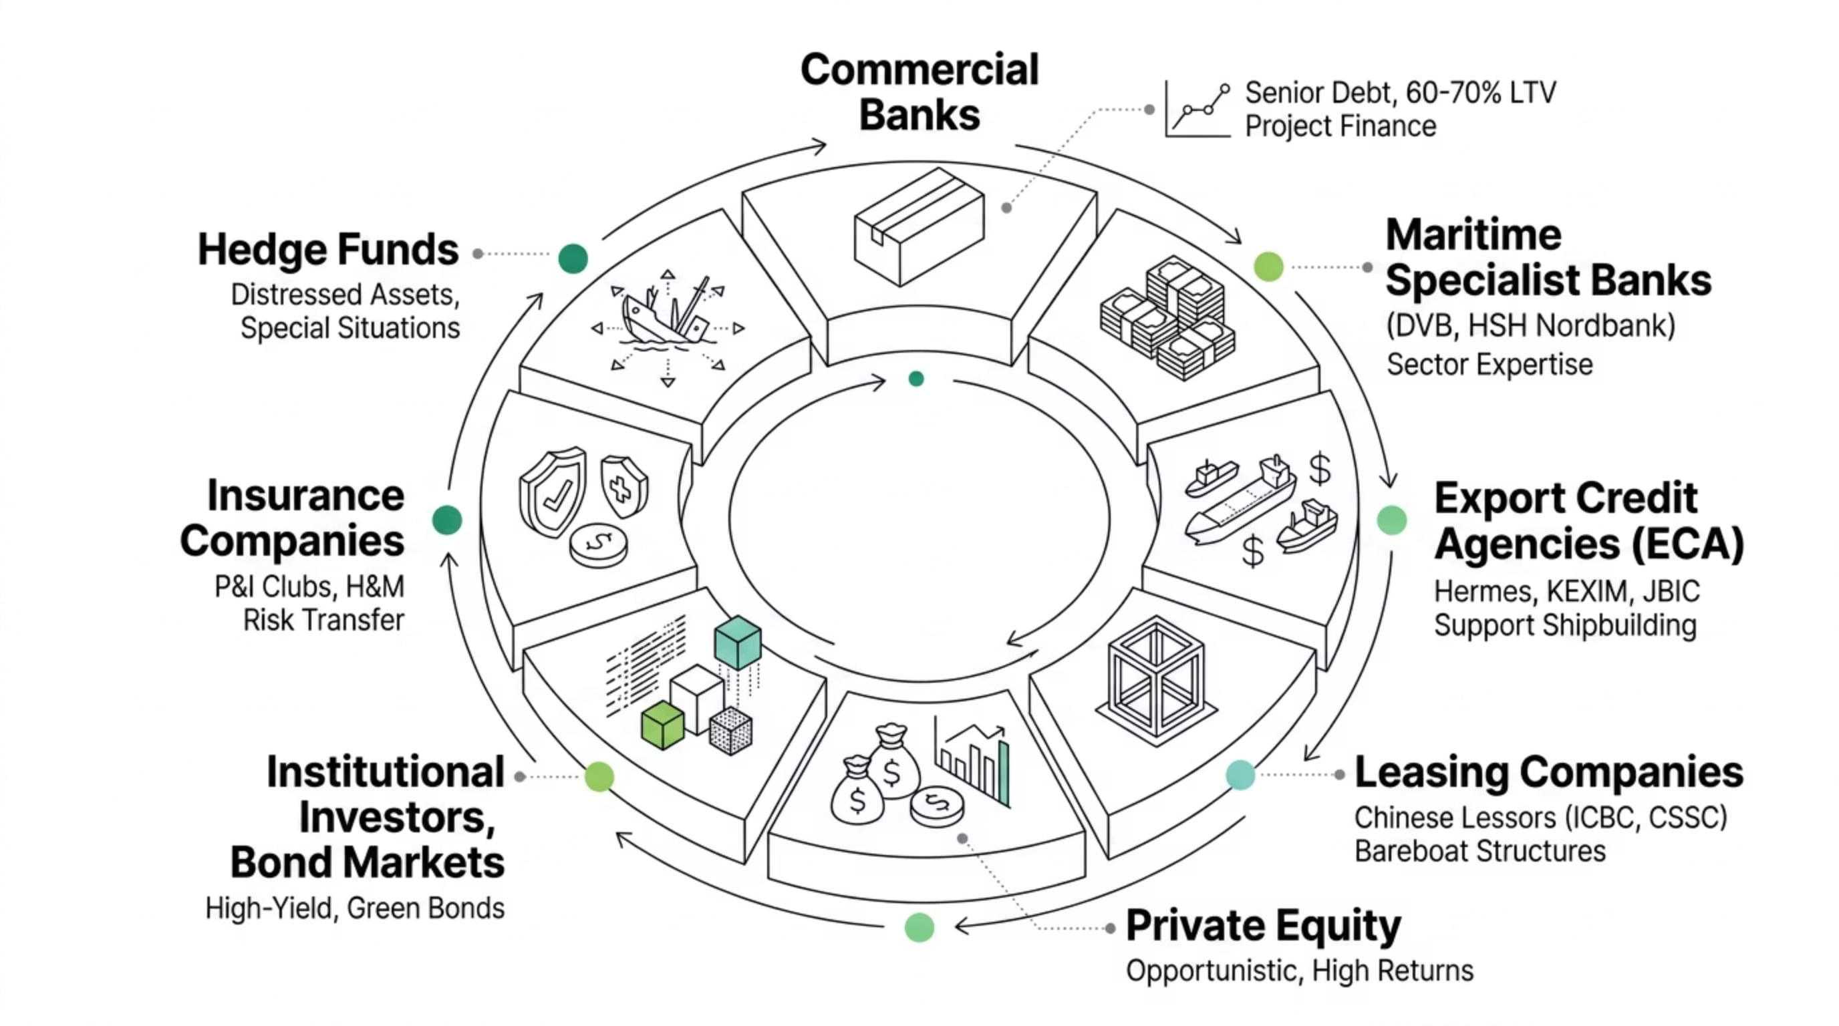
PART VI
ECOSYSTEM OVERVIEW
The Shipping Finance Ecosystem
Vessel acquisition and operation are funded by a diverse capital marketplace. Understanding who provides capital — and why — is central to structuring effective shipping finance.

Slide 35




Key Financing Participants
Commercial & Maritime Banks
Export Credit Agencies
Leasing Companies
Private Equity & Bond Investors
Government-backed. Support shipbuilding in their home country. KEXIM (Korea), JBIC (Japan), Euler Hermes (Germany). Offer concessional rates and long tenors (12+ years).
Chinese lessors (ICBC, CSSC, CMBFL) have grown dramatically since 2010. Use bareboat structures and sale-leaseback deals. Now a dominant source of global ship finance.
Traditional senior lenders. Provide 60–70% of vessel value as secured loan. Interest rate typically SOFR + margin. Require charter contracts, insurance, and flag assignment as security.
Target distressed assets, fleet growth opportunities, or green shipping. High-yield bonds and sustainability-linked bonds are increasingly used by major shipping companies.

Slide 36

PART VII
80–90 MINUTES
Shipping Market Cycles
Perhaps the single most important concept in shipping finance: the industry moves in powerful, recurring cycles that determine when to invest, when to borrow, and when to exit.

Slide 37








The Four Phases of the Shipping Cycle
Martin Stopford's framework of four shipping market phases remains the most widely used model for understanding how freight rates, vessel values, and investment appetite evolve over time.
Recovery
Peak
Freight rates begin rising. Fleet utilization increases. Cautious owners begin ordering new vessels. Banks start re-engaging with shipping clients.
High freight rates and vessel values. Euphoric ordering. Shipyards at full capacity. Easy credit availability. Warning signs often ignored.
Trough
Downturn
Loss-making freight rates. Mass scrapping. Distressed asset sales. Banks write off loans. Opportunistic buyers acquire assets cheaply.
New vessel deliveries flood supply. Freight rates collapse. Banks tighten lending. Vessel values plummet. Financially weak owners face default.

Slide 38
How Cycles Affect Financing Decisions
Cycle Phase
Freight Rates
Vessel Values
Financing Environment
Recovery
Rising moderately
Increasing from lows
Banks cautiously re-open; good entry point for equity
Peak
Very high / record levels
At maximum
Easy credit; dangerous time to buy assets at peak price
Downturn
Falling sharply
Declining fast
Banks restrict lending; covenant breaches emerging
Trough
Below operating cost
At cyclical low
Finance nearly impossible; best time for opportunistic buyers

Slide 39

Historical Cycle Case Studies
The 2008 Financial Crisis
COVID-19 Container Boom (2020–2022)
Post-Pandemic Correction (2023–Present)
The BDI collapsed 94% in 7 months. Shipowners who had ordered at peak prices with peak debt found themselves with vessels worth less than the outstanding loans — triggering mass defaults and a prolonged banking crisis in shipping.
Pandemic-driven consumer spending surge, port congestion, and container shortages sent freight rates to extraordinary levels. SCFI reached 5,000+ points. Shipping companies booked record profits — Maersk earned USD 30B in 2022 alone.
Normalization of supply chains, new vessel deliveries, and slowing consumer demand caused container rates to collapse. The Red Sea crisis in late 2023 created a new, shorter disruption with temporary rate spikes.

Slide 40
The Investor's Dilemma: Timing the Cycle
The Classic Mistake
The Contrarian Strategy
The most common and costly error in shipping investment is ordering at the peak. When rates are high and sentiment is euphoric, banks are willing to lend, shipyards have long order books, and everyone is optimistic. Vessels ordered at peak prices are typically delivered into a downturn — the worst possible scenario for the owner and the lender.
The most successful shipping investors — John Fredriksen, George Economou, and private equity funds — buy distressed assets in the trough for a fraction of replacement cost, wait out the cycle, and sell or refinance at the peak. This requires patient capital, industry knowledge, and the nerve to invest when headlines are uniformly negative.

Slide 41


PART VIII
90–100 MINUTES
Classroom Activity
Apply the concepts from this session to a real-world vessel acquisition decision.

Slide 42

Group Exercise: Financing a Panamax Bulk Carrier
Scenario: A company wishes to purchase a new Panamax bulk carrier with a price of USD 50 million. Available equity: USD 10 million. The remaining USD 40 million must be financed.
1
2
Financing Structure
Available Options
How should the remaining USD 40 million be raised? What debt-to-equity ratio is appropriate? What are the typical terms — tenor, amortization, security requirements?
Which financing instruments are suitable? Commercial bank loan? ECA financing? Leasing? Bond issuance? Which is most appropriate for a Panamax bulker and why?
3
4
Stakeholders Involved
Risk Assessment
Who will participate in this transaction? Lenders, lawyers, insurance brokers, classification society, flag state, broker — map the full deal team.
What are the key risks? Market risk, counterparty risk, technical risk, currency risk, regulatory risk — how would you evaluate and mitigate each?
Each group presents its recommendation in 2–3 minutes. Be prepared to justify your financing choice and identify the top two risks.

Slide 43
Discussion Prompts & Quick Quiz
Discussion Questions
Quick Quiz
Why is a time-chartered vessel more attractive to a bank than a spot-trading vessel?
At what point in the shipping cycle would you advise a client to order a new vessel? Why?
How does the choice between voyage, time, and bareboat charter affect a shipowner's cash flow predictability?
Why do classification societies matter to shipping financiers?
What percentage of global trade by volume is carried by sea?
Name three major shipping segments.
What is the difference between a time charter and a bareboat charter?
Name the four phases of the shipping cycle.
Why did BDI collapse in 2008?

Slide 44
Session Summary: Key Takeaways
Shipping Underpins Global Trade
Maritime Assets Require Long-Term Investment
80–90% of world merchandise trade moves by sea. Without shipping, modern civilization as we know it ceases to function within weeks.
Ships cost tens to hundreds of millions of dollars and operate for decades. Financing must match the asset life and revenue profile — not standard corporate loan terms.
Shipping Finance Is an Interdisciplinary Field
Cycles Are Central to Every Decision
It integrates economics, maritime law, naval engineering, financial markets, and geopolitics — no other sector demands such breadth of knowledge from its financiers.
Whether buying, selling, chartering, or borrowing — the phase of the shipping cycle is the most critical contextual variable. Timing is everything.

Slide 45
Suggested Assignments
Assignment 1
Assignment 2
Research a publicly listed shipping company — choose from Maersk (Denmark), MSC (Switzerland), SCI (India), or Great Eastern Shipping (India).
Prepare a one-page analytical note on the impact of the COVID-19 pandemic on shipping freight rates and financing decisions between 2020 and 2022.
Identify its primary business model (ownership, management, chartering)
Determine its main sources of finance (bank loans, bonds, equity)
Review its last annual report for debt levels and key financial ratios
Which segments benefited most? (containers vs. tankers vs. bulk)
How did banks and lessors respond to the shipping boom?
What happened to freight rates and vessel values post-2022?
Submission: One-page note with supporting data from published sources (Clarkson, Platou, Lloyd's List).
Submission: 500-word structured note + financial data summary table.

Slide 46
What's Coming Next: Module 2 Preview
Module 2 will build on today's foundations, moving from industry structure to quantitative market analysis — where finance, economics, and data converge.
Freight Market Analysis
Supply-Demand Dynamics
Vessel Valuation
How freight rates are formed, negotiated, and benchmarked using indices like the BDI, BDTI, and BCTI.
Modeling fleet supply, new orders, scrapping, and demand drivers to forecast market direction.
Methods for valuing vessels: income approach, market comparables, depreciated replacement cost, and discounted cash flow under multiple freight scenarios.

Slide 47

Supplementary Reading & Resources
Core Textbooks
Industry Data Sources
Regulatory & Industry Bodies
Stopford, M. — Maritime Economics (3rd ed., Routledge)
Kavussanos & Visvikis — Derivatives and Risk Management in Shipping
Grammenos, C.Th. — The Handbook of Maritime Economics and Business
Clarkson Research — vessel values, fleet data, freight rates
Baltic Exchange — BDI, BDTI, BCTI, BLPG indices
Lloyd's List — shipping news and analysis
Platou (RS Platou/Clarksons) — annual shipping market report
IMO.org — regulations, conventions, decarbonization targets
BIMCO.org — standard charterparties, market intelligence
DGShipping.gov.in — Indian maritime regulatory framework

Slide 48
Key Terminology Glossary
Term
Definition
DWT
Deadweight Tonnes — the total weight a vessel can carry including cargo, fuel, and stores
BDI
Baltic Dry Index — composite freight rate benchmark for dry bulk shipping (Capesize, Panamax, Supramax)
LTV
Loan-to-Value — the ratio of the loan amount to the vessel's appraised market value
CapEx
Capital Expenditure — the cost of acquiring or improving a vessel; a major financing event
OpEx
Operational Expenditure — daily vessel running costs: crew, maintenance, insurance, lubes
SOFR
Secured Overnight Financing Rate — the benchmark interest rate replacing LIBOR for USD loans
ECA
Export Credit Agency — government body providing subsidized financing for vessel construction
P&I Club
Protection & Indemnity Club — mutual insurer covering third-party liability for shipowners

Slide 49
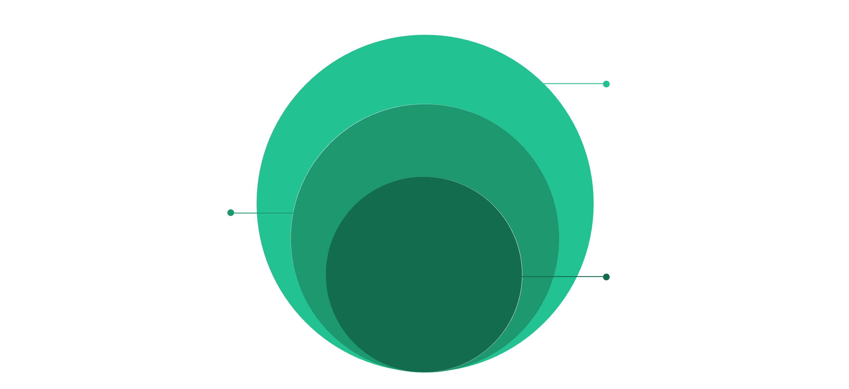
Visual Summary: The Shipping Finance Framework
Every concept from this session connects within a unified framework. Shipping finance is the mechanism that converts capital into vessels, vessels into services, and services into global trade flows.
Shipping Markets
Freight rates, vessel supply, market cycles
Business Models
Ownership, management, voyage/time/bareboat chartering
Shipping Finance
Banks, ECAs, lessors, PE, bonds structuring capital
Each layer influences the one below it. A recession at Layer 1 ripples down to freight rate collapse at Layer 2, which destroys income at Layer 3, ultimately triggering financing stress at Layer 4. This interconnection is what makes shipping finance both challenging and intellectually rich.

Slide 50
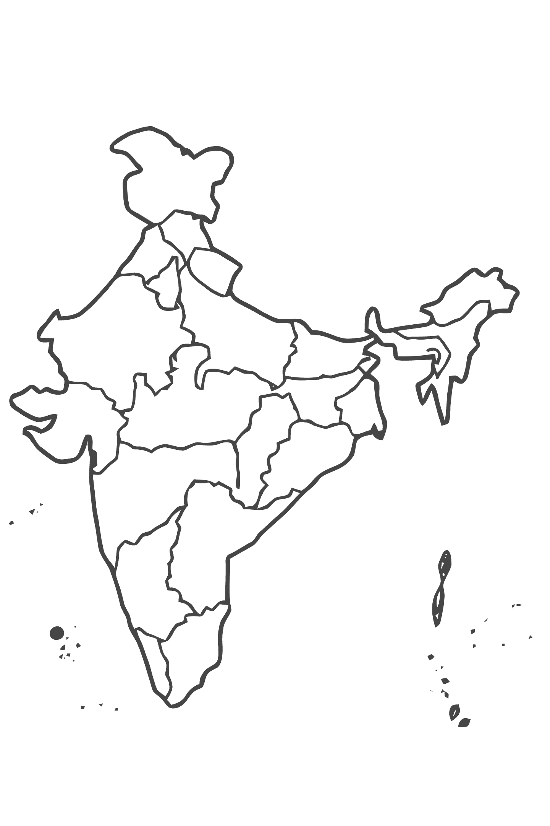
India in the Global Shipping Context
India handles approximately 1.5 billion tonnes of cargo annually through its 12 major and 200+ minor ports. Yet India's share of the global merchant fleet remains below 2%. This gap represents both a policy challenge and an investment opportunity of enormous scale.
Sagarmala Programme
Maritime India Vision 2030
USD 120B government initiative to modernize ports, improve port-led industrialization, and develop coastal shipping infrastructure through 2035.
Targets to triple port capacity, build 23 new waterways, expand the merchant fleet, and position India among the top 10 maritime nations globally.
Shipbuilding Opportunity
CSL, L&T Shipbuilding, and ABG Shipyard represent India's emerging shipbuilding capacity. Government policy targets significant domestic vessel construction growth through PLI incentives.

Slide 51

The Decarbonization Imperative
Why This Matters for Finance
The IMO has set targets to reduce shipping's carbon intensity by 40% by 2030 and achieve net-zero greenhouse gas emissions by 2050. This creates a massive forced capital replacement cycle — older, polluting vessels will be stranded assets.
Key Implications
Green ammonia, methanol, and LNG dual-fuel vessels command premium financing terms
Carbon pricing (EU ETS from 2024) directly affects operating economics
ESG-mandated lenders are restricting finance for high-emission vessels
Green bonds and sustainability-linked loans are rapidly growing instruments

Slide 52




Career Pathways in Maritime Finance
This course prepares students for a wide range of specialized roles at the intersection of finance, law, and maritime operations.
Ship Finance Banker
Maritime Private Equity
Structuring and underwriting vessel acquisition loans at maritime banks such as Nordea, ABN AMRO, or SBI in India.
Managing distressed vessel acquisitions, fleet growth strategies, and exit planning for shipping-focused private equity funds.
Chartering & Derivatives
Corporate Treasury — Shipping Companies
Trading Forward Freight Agreements (FFAs), advising on charter strategy, and managing freight rate risk for shipowners and charterers.
Managing debt portfolios, hedging programs, capital markets access, and investor relations for publicly listed shipping companies.

Slide 53
Shipping Finance vs. Project Finance vs. Corporate Finance
Dimension
Shipping Finance
Project Finance
Corporate Finance
Primary Security
Vessel mortgage + earnings assignment
Project assets + cash flows
Balance sheet / corporate guarantee
Revenue Visibility
Low (spot) to medium (TC)
High (long-term offtake)
Moderate (product revenue)
Asset Mobility
High — vessel can be repositioned
Zero — fixed in place
Mixed — depends on business
Typical LTV
60–70%
70–90%
Varies widely
Loan Tenor
8–12 years
15–25 years
3–7 years

Slide 54
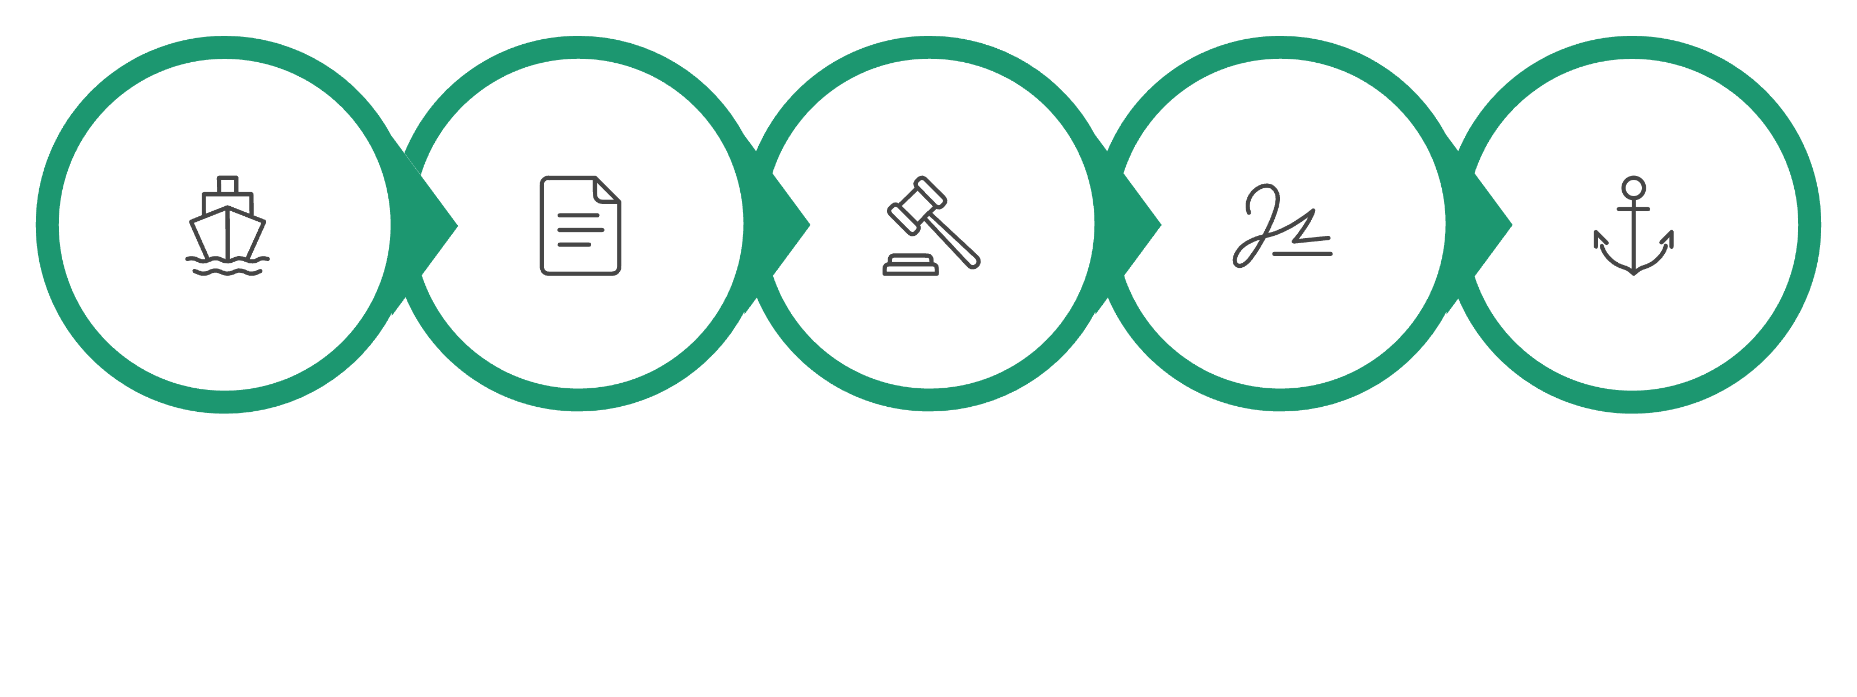
How a Ship Financing Deal Works
Understanding the transaction flow from vessel selection to drawdown helps students appreciate the interdependence of all participants in the maritime finance ecosystem.
Vessel Selection
Valuation & Term Sheet
Legal Diligence
Loan & Mortgage
Delivery & Insurance
This process typically takes 3–6 months for a straightforward bank loan and up to 12 months for ECA-backed or complex structured finance. Each step involves lawyers, brokers, surveyors, insurers, and regulators working in parallel.

Slide 55
Forward Freight Agreements (FFAs): An Introduction
What Are FFAs?
Who Uses FFAs and Why?
Forward Freight Agreements are financial derivatives that allow market participants to lock in future freight rates. They are cash-settled contracts based on Baltic Exchange indices (BDI, BDTI, etc.) and traded over-the-counter or through the LCH clearinghouse.
Shipowners — sell FFAs to hedge against falling freight rates
Charterers/Traders — buy FFAs to hedge against rising freight costs
Hedge funds — speculate on directional freight movements
Banks — use FFA market data to stress-test shipping loan portfolios
FFAs will be covered in depth in a later module on shipping derivatives and risk management.

Slide 56
The Baltic Dry Index Explained
The Baltic Dry Index (BDI) is the world's most widely followed benchmark for dry bulk shipping freight rates, published daily by the Baltic Exchange in London since 1985.
What It Measures
Why It Matters
Historical Range
A composite of Capesize, Panamax, and Supramax freight rate assessments across 20+ major global shipping routes. Expressed as a single index number.
The BDI is a leading economic indicator — it reflects real physical demand for commodities before those goods appear in trade statistics, making it a forward-looking gauge of global industrial activity.
BDI has ranged from a low of 290 (Feb 2016) to a high of 11,793 (May 2008). The COVID-19 peak reached ~5,650 in October 2021 during the container supply chain crisis.

Slide 57


Shipping Finance and ESG: A New Paradigm
Environmental, Social, and Governance (ESG) criteria are rapidly reshaping who gets financed in shipping — and on what terms. This is not a future trend; it is already embedded in lender policies.
Environmental
Social
Governance
CII ratings, EEXI compliance, carbon intensity targets. Non-compliant vessels face higher interest margins and restricted access to capital markets and EU ports.
Seafarer welfare (MLC 2006 compliance), crew nationality diversity, and labor standard audits are increasingly required by ESG-mandated institutional lenders.
Corporate transparency, anti-corruption compliance, beneficial ownership disclosure, and sanctions screening are now standard lender requirements in ship finance KYC.

Slide 58

A Day in the Life: Ship Finance Professional
"Every deal I work on involves a different vessel, a different flag state, a different legal jurisdiction, and a different market outlook. No two deals are ever the same — that's what makes ship finance the most interesting corner of banking." — Senior Director, Maritime Finance, DVB Bank
Ship finance professionals combine the analytical rigor of credit analysis with deep market knowledge, legal complexity, and genuine physical asset understanding. A typical day might involve credit committee preparation, covenant compliance review, vessel inspection reports, freight market analysis, and charter counterparty assessment — all for the same transaction.

Slide 59
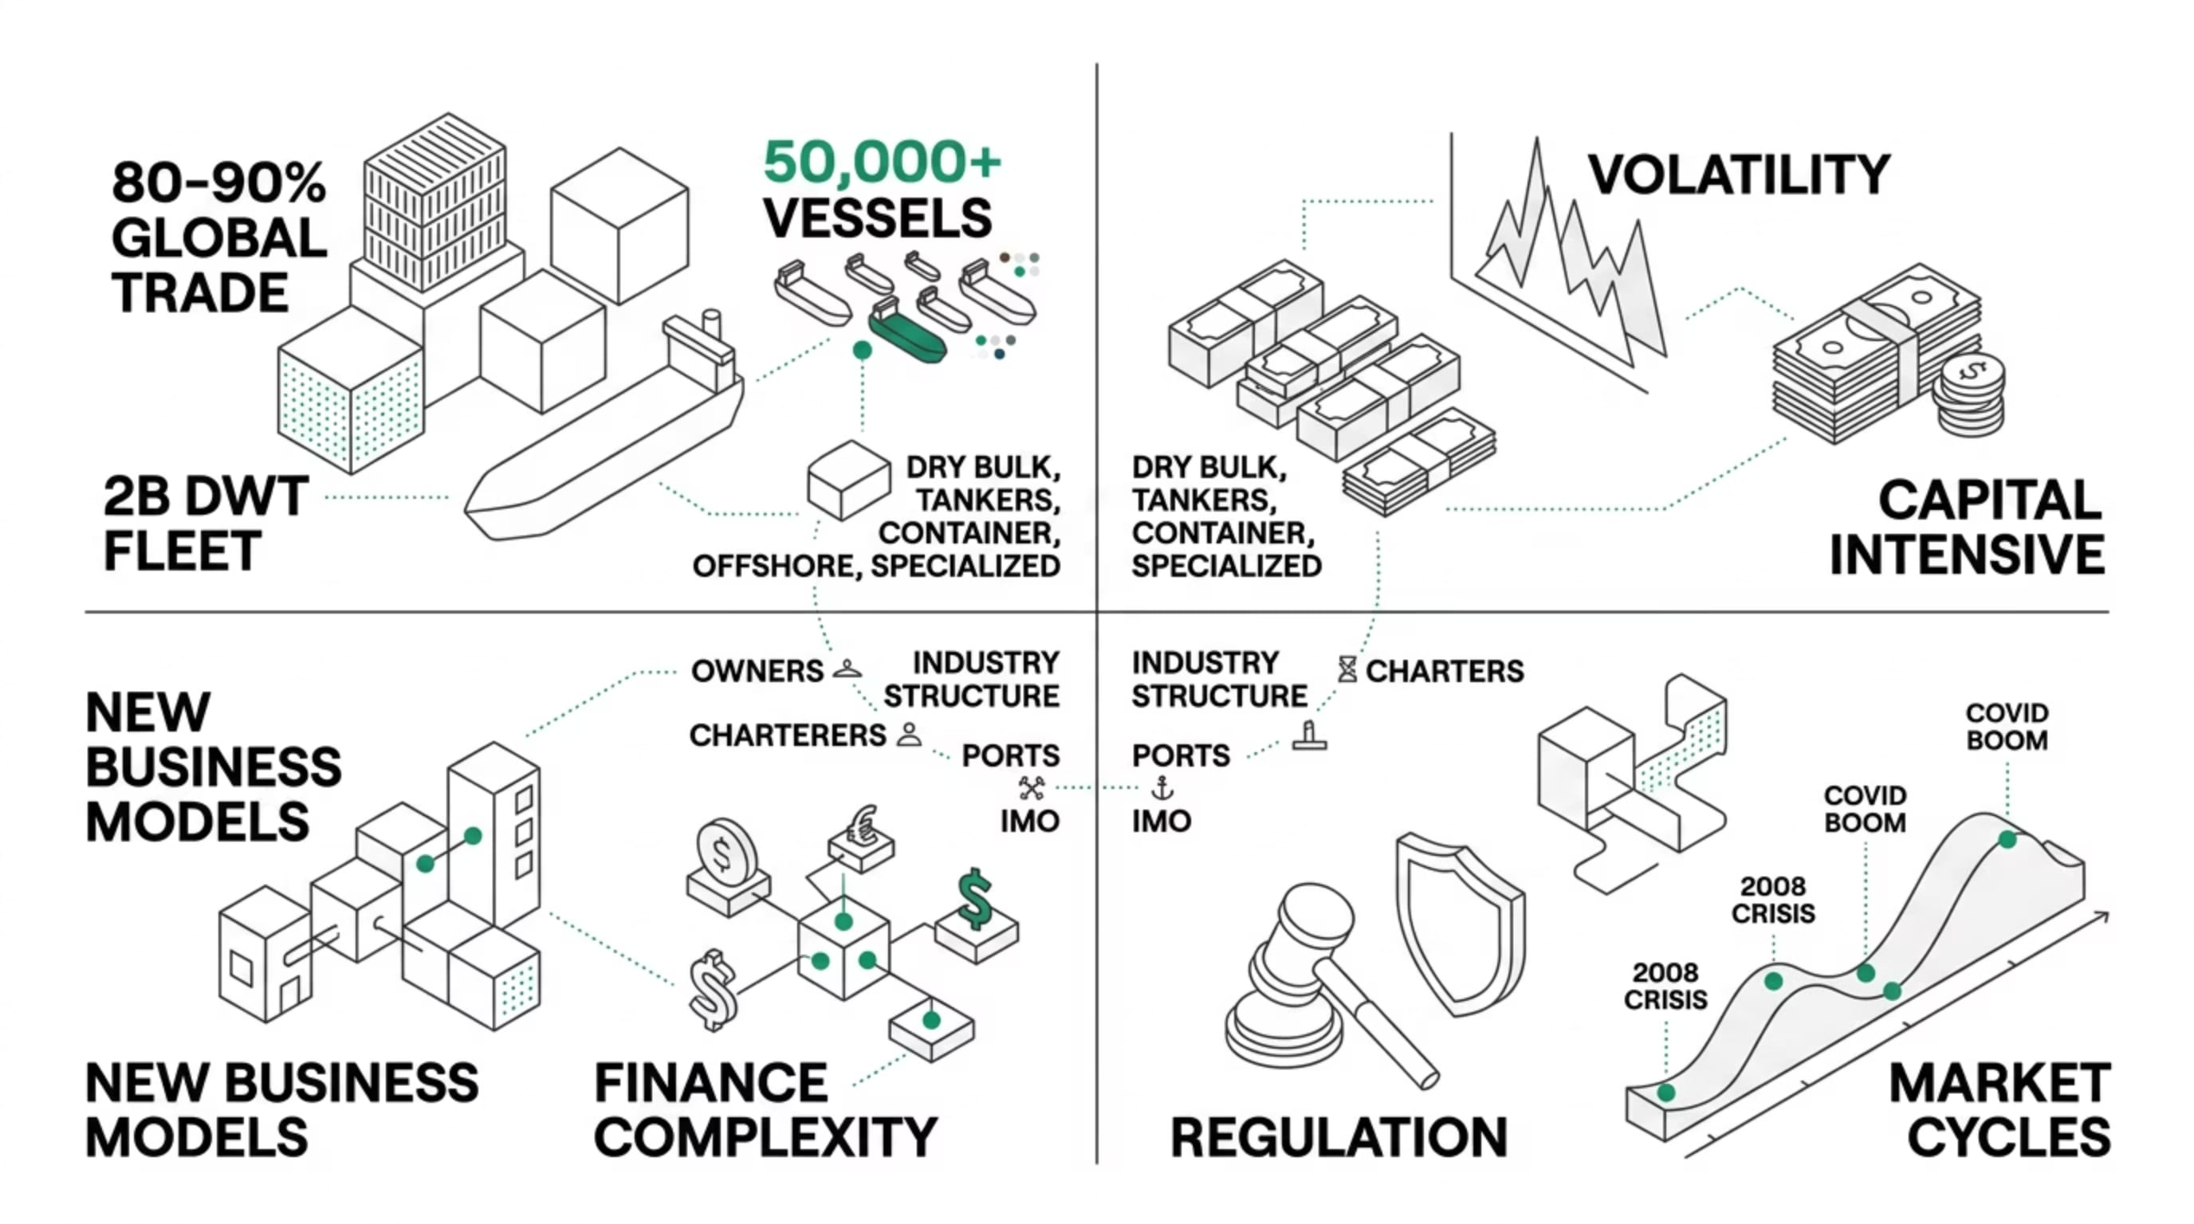
Module 1 — Complete Concept Map
Use this as a study reference to connect all the concepts covered in this foundational session before proceeding to Module 2.

Slide 60
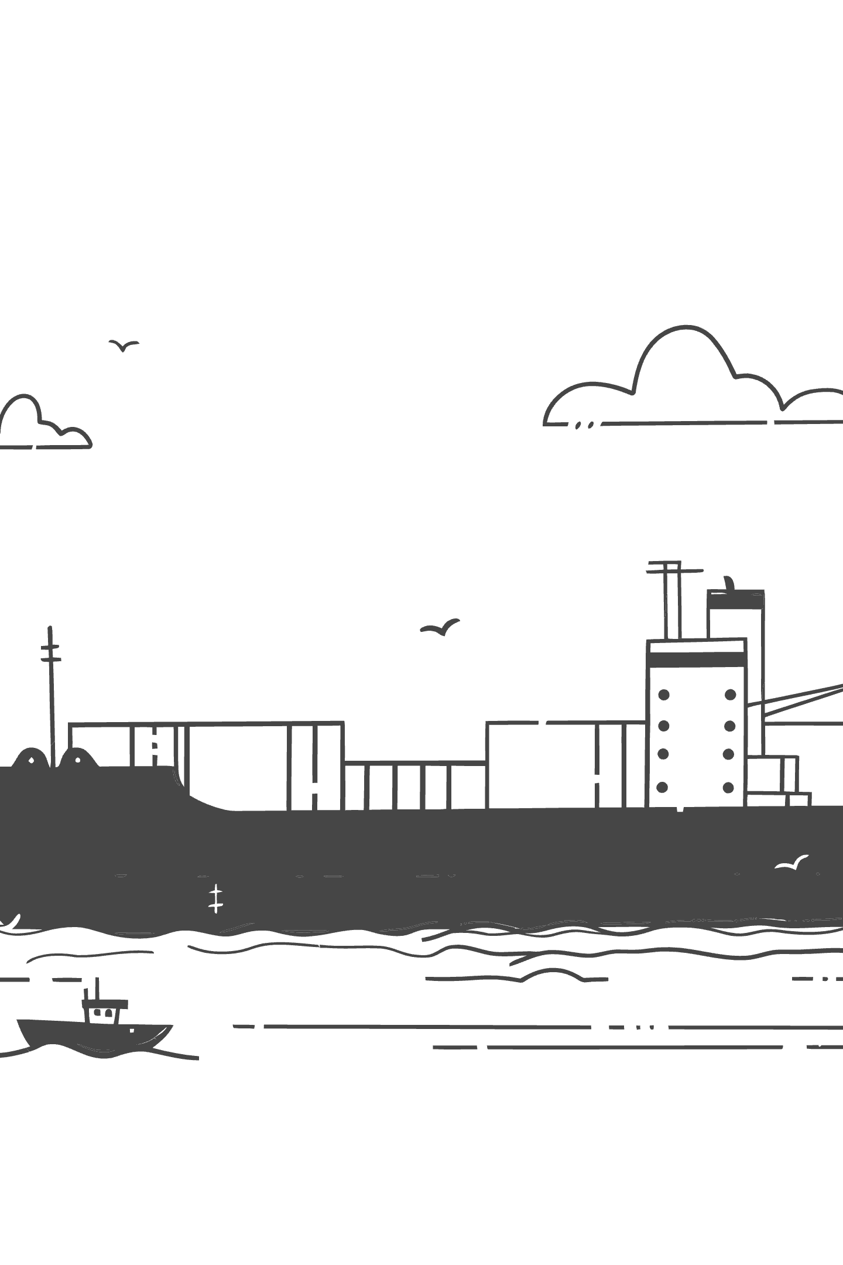
Thank You
Module 1 Complete — Foundations of the Maritime Financial System
You now have the foundational framework to understand how global shipping works, why it requires specialized finance, and how market cycles shape every investment and lending decision in this industry. In Module 2, we move into quantitative freight market analysis and vessel valuation — where the numbers come alive.
Next Session
Assignments Due
Maritime Economics & Shipping Markets — freight rate formation, supply-demand modeling, and vessel valuation methods
Shipping company research note + COVID-19 freight rate impact analysis — submit before next class
Key Resources
Stopford's Maritime Economics, Baltic Exchange website, and Clarkson Research portal — your essential references

